Slide 1
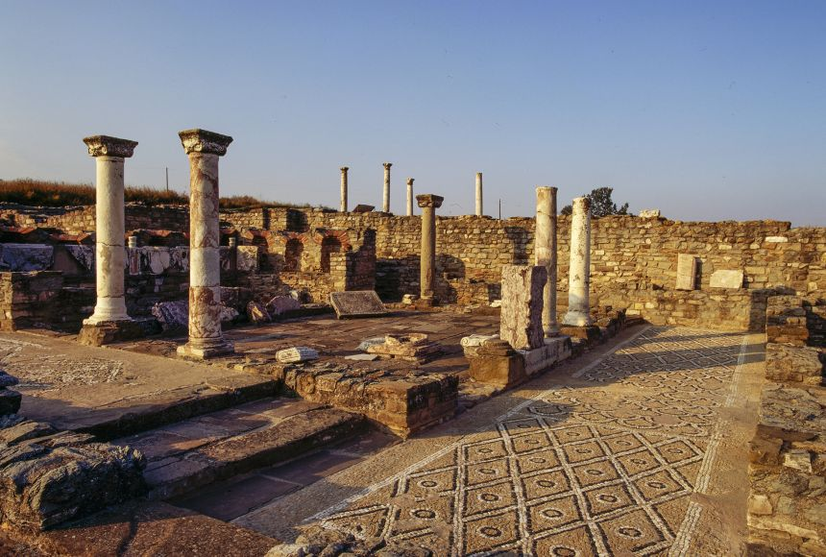
Unit 2 – Power in the Ancient World
Goal/s:
Discuss Unit 2
Identify the features of ancient macedonia
Week 1 Lesson 1 – unit 2
Ms Barrie

Slide 2
Welcome to Ancient History
Ms Lauren Barrie
Lauren.barrie@education.wa.edu.au
Classroom:
F18
Where to find me:
Downstairs HASS Staff Study

Slide 3
Class Rules and Expectations
Show respect to me, each other, and the classroom
Be on time for class
Come prepared for class
Complete all tasks to the best of your ability
Catch up on missed work
Have a go at everything
Use Compass
If you do not follow these, your parents/guardians will be contacted.

Slide 4

What you will need
Workbook to write in
Pen for EVERY class (it is not expected that you rule up)
File for worksheets
Folder for assessments
Workbook, file, and folder will remain in the class

Slide 5
Unit 2 – Power in the Ancient World
In this unit, students learn that, in ancient societies, key individuals have acted as agents of change, interacting with groups and institutions, and using their power to shape their society.
They investigate key individuals’ motives, the methods they used to achieve power, the ways they used their power, the responses of others to their use of power, and their impact and influence on society.
Students also learn that individuals, groups, and institutions have a variety of types of power, and that power is not distributed evenly throughout the society.

Slide 6
Week 1 | Overview of Ancient Macedonia
Week 2 - 4 | Alexander the Great | Source Analysis Week 3
Week 5 | Overview of Ancient Rome | Test Week 8 Explanation (Essay) Week 10
Week 8 – 10 | Julius Caesar
Week 11 - 14 | Investigation of an Ancient Person Questioning and research Explanation and Communication | Inquiry Project Week 11 - 14

Slide 7

Any questions?

Slide 8
ACTIVITY 1 – Video
Watch the following video: https://www.youtube.com/watch?v=3cHA56C9EqY&ab_channel=SeeUinHistory%2FMythology
Take down 5 dot-points about Ancient Macedonia.
Be prepared to discuss!

Slide 9
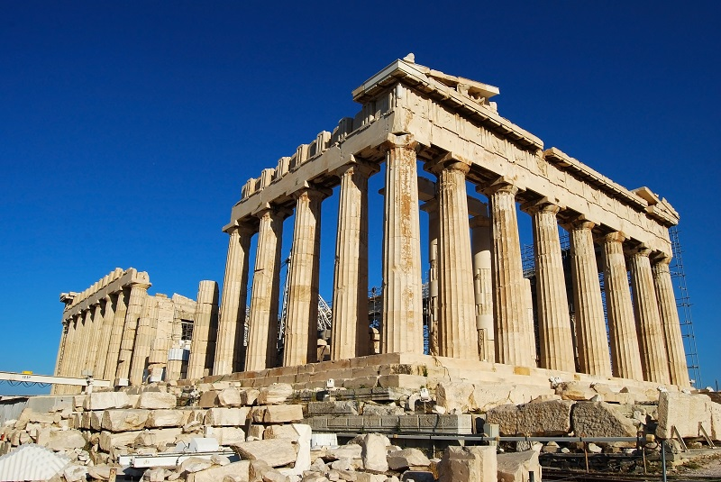
Hellenic
DEFINITION:
relating to the ancient Greeks (especially before the time of Alexander the Great)
Write this in your book

Slide 10
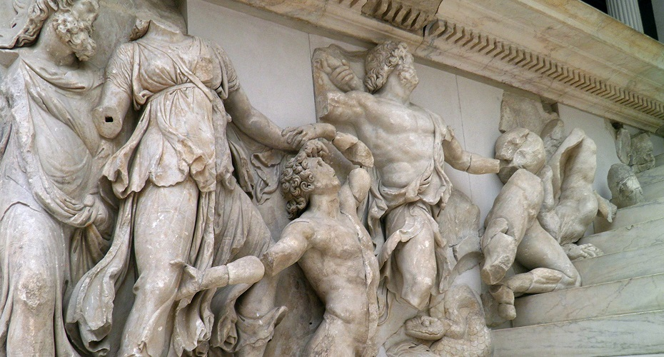
Hellenistic
DEFINITION:
the period of Mediterranean history between the death of Alexander the Great in 323 BC and the emergence of the Roman Empire.
Write this in your book

Slide 11
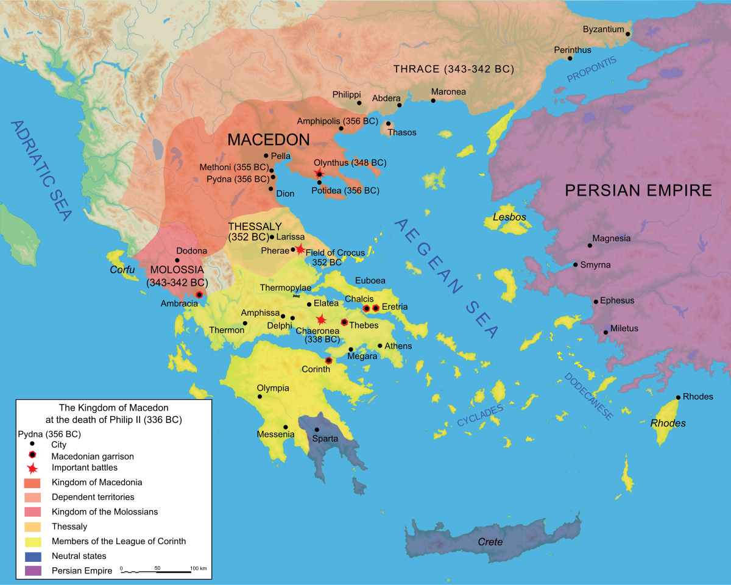
League of Corinth
DEFINITION:
offensive and defensive alliance of all the Greek states (except Sparta) organized in 337 BCE at Corinth under the leadership of Philip II of Macedon.
Write this in your book

Slide 12
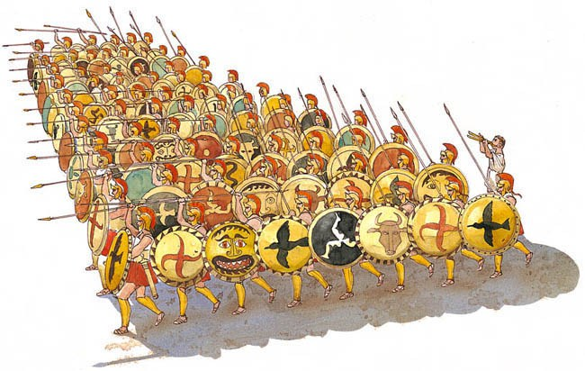
Phallanx
DEFINITION:
a body of troops or police officers standing or moving in close formation
Write this in your book

Slide 13
Our Focus:
Ancient Macedonia and Alexander the GReat

Slide 14
Ancient Macedonia
Macedonia - small kingdom in northern Greece
established a growing empire from 359 BCE to 323 BCE
reign of several kings - monarchy began in 808 BCE with Caranus (first known king of Macedonia)
359 BCE - King Phillip II became ruler and united the southern Greek city-states with the north
brought them all under Macedonian rule
improved his army
devised plans to conquer other lands in the Mediterranean
died before he was able to put his plans into action
His son Alexander, later known as Alexander the Great, was able to expand Macedonia and usher in the Hellenistic age in the region.

Slide 15

Geography
Colour the following onto your map and label

Slide 16

Where is Macedonia?

Slide 18
Geography
Mountains divided the Greeks into independent city-states
Access to the sea allowed for trade and cultural diffusion (sharing of ideas)
Wealth and innovation made it a target for invasion

Slide 19
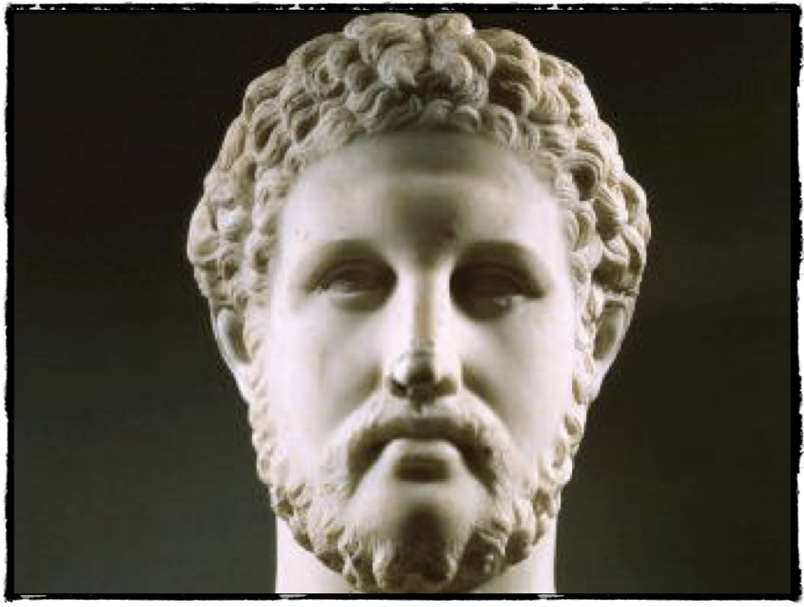
Who am I?
King Philip II of Macedon
382BC – 336BC

Slide 20
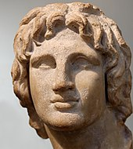
Who am I?
Alexander III of Macedon
356BCE – 323BCE

Slide 21
ACTIVITY 2 – Reading Comprehension
Read through the information about King Phillip II and Alexander the Great.
Complete the questions on your worksheet.

